Slide 1

Efficacy of Artificial Intelligence Models in Advanced Mathematics
Joey Fischer
3/1/2025

Slide 2

Purpose of Study
AI is rapidly expanding in use cases:
Business
Education
Government
Daily Life
I wanted to create a better understanding of the shortcomings of current AI Models and place that within the larger framework of AI development
I asked 5 AI models to solve 8 problems I had done during my time as an undergraduate and graded them on their effectiveness
Tried to find where exactly the models made errors and the underlying causes of those errors
AI Development Lifecycle
Develop
Design
Design
Deploy

Slide 3
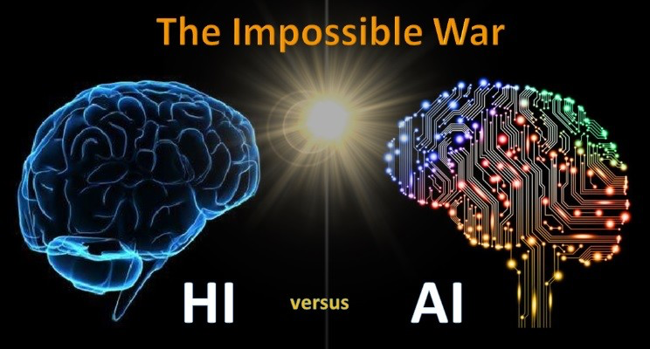
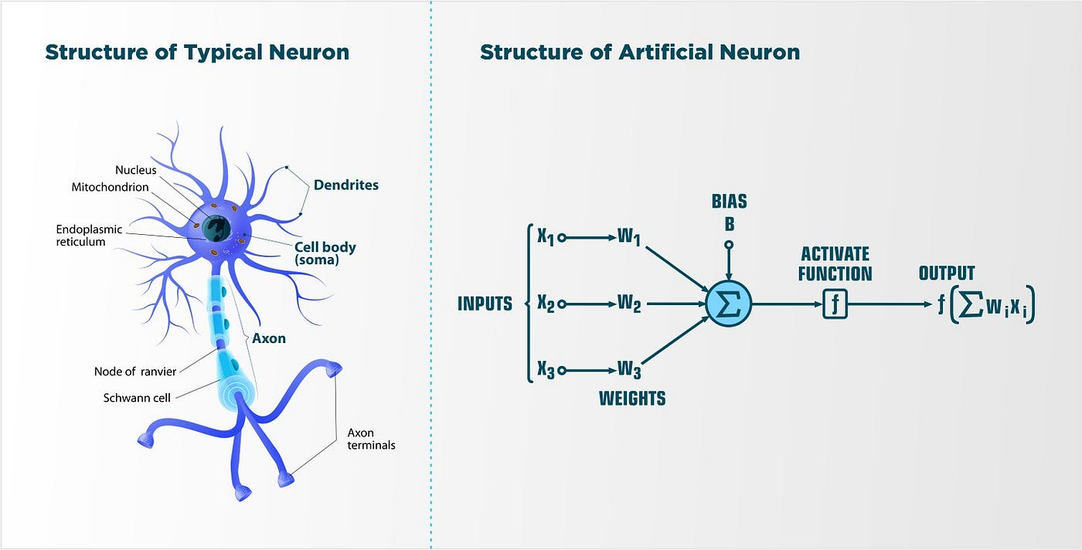
Human Brain
AI Model
Dendrites send signals to somas
Signal strength is based on weights and biases
Based on the neural network in the human brain
Numerical weights and biases influence an activation function

Slide 4


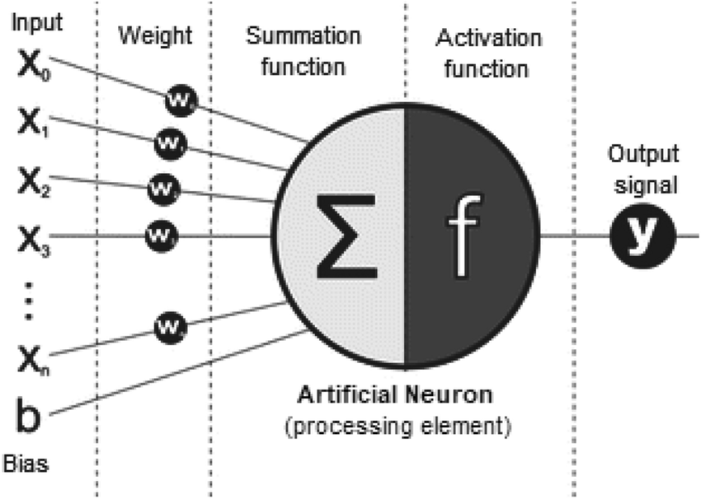


Mathematical Foundation of AI
Model Training
There is a training dataset and a test dataset
The model is run on the training dataset with random weights and biases
Performance is measured by a loss function:
Formula for an Artificial Neuron
With weights:
Input vectors:
An activation function:
And shifted by a bias b ∈ ℝ.

Slide 5



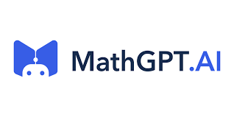

Methods
Two questions each were chosen from
Inputs were coded in LaTex format in the exact same wording
No AI had issue reading this format
AI outputs were then compared to prepared possible solutions for each question and graded on their accuracy (note this has some room for subjectivity)
Five chatbots that advertise their ability to solve mathematical problems were faced with 8 undergraduate level mathematical questions
Reasoning and Proofs
Geometry
Abstract Algebra
Real Analysis
Thetawise

Slide 6
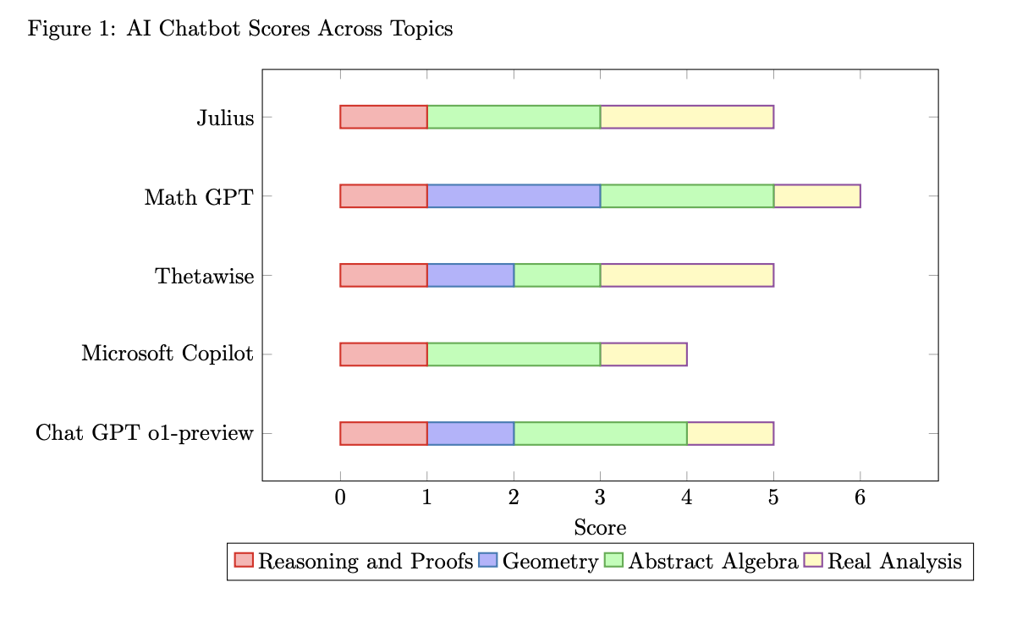
Results
Microsoft Copilot performed the worst with 4 correct answers
Math GPT performed the
best with 6 correct
All of the others had 5 correct
There was not a sizeable difference in performance

Slide 7
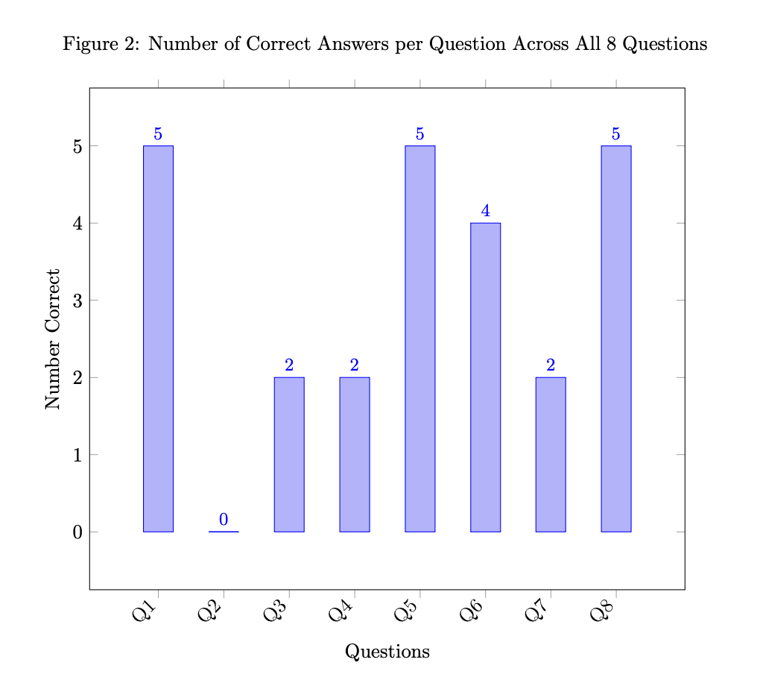
Results by Question
3 questions were easily passed by all 5 models
1 question was failed by all 5 models
This is easily solved by induction but none of the AI models tried induction
They mostly tried to manipulate the algebra before giving up and declaring the statement true and/or committing algebra mistakes

Slide 8
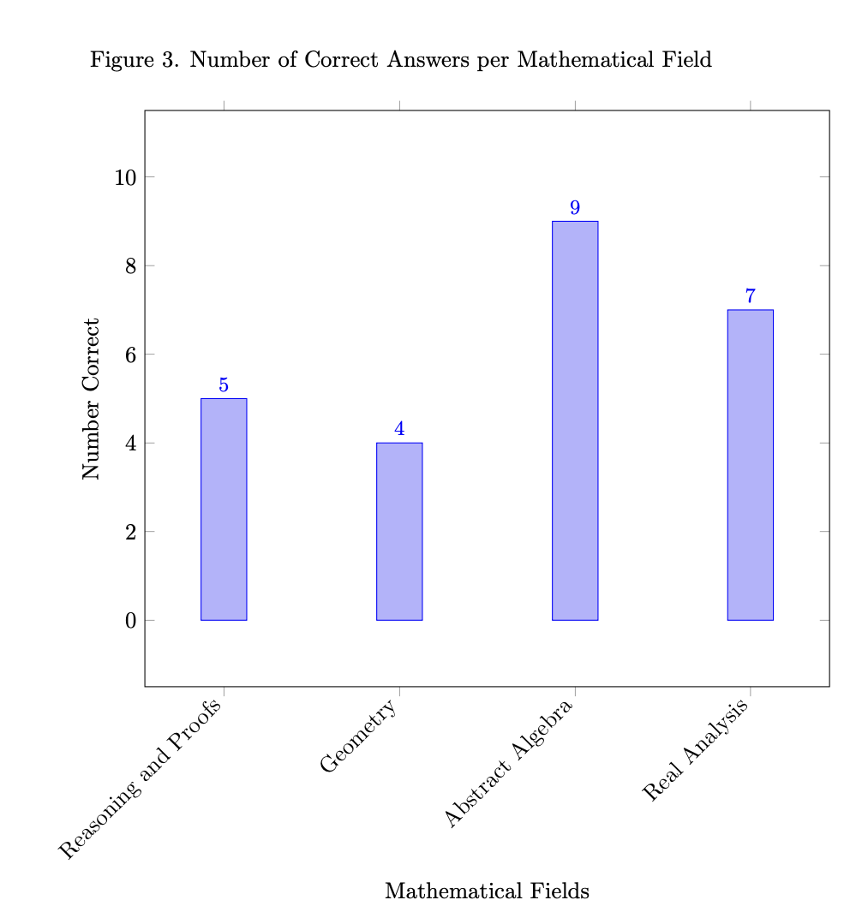
Results by Fields
Abstract Algebra was the best performing subject with 9 correct out of 10
Geometry had the least with 4 correct out of 10
Possibly the models have a hard time visualizing geometric problems

Slide 9
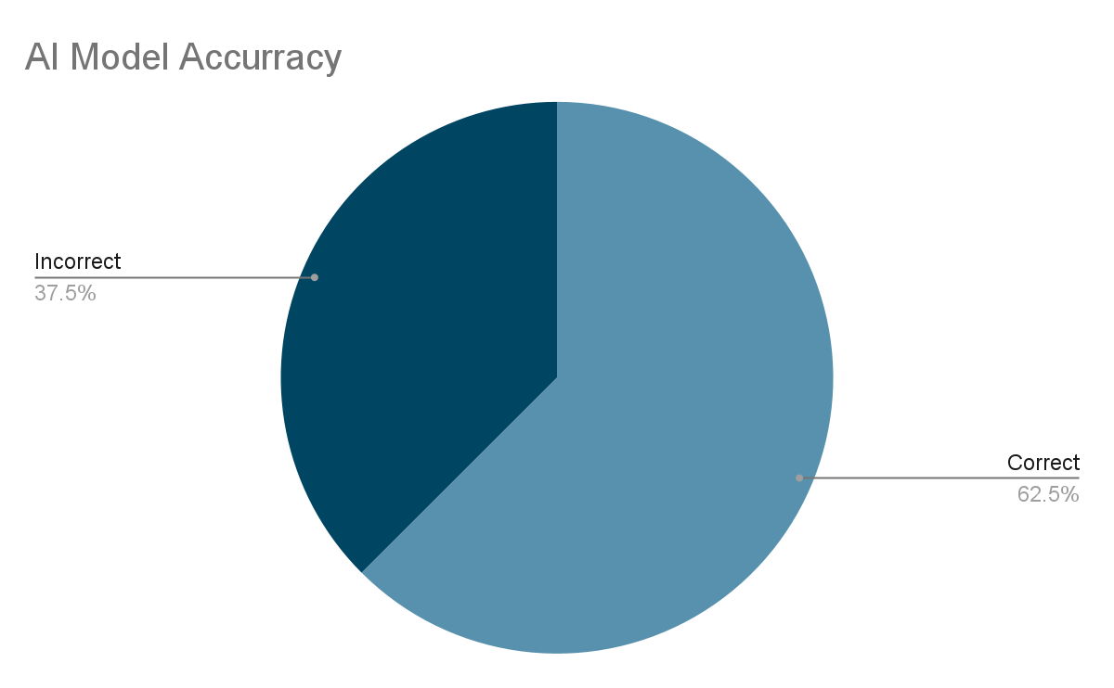
Conclusion
Failure is attributed to 2 factors
Current training sets lack theoretical foundations
AI models provide statistical approximations
i.e. They are unable to use deductive reasoning
Similar studies performed in larger scales produced worse results
“Frontier Math,” a mathematical benchmark for assessing AI had a <2% success rate
Overall the success rate of AI models when faced with the mathematical problems in this study was 62.5%

Slide 10
Citations
S. Zhu, L. Zhang, and Y. Wang, “The future of artificial intelligence
in mathematical reasoning: Opportunities and challenges,” Artificial
Intelligence Review, vol. 56, pp. 1325–1352, 2024. [Online]. Available:
https://www.sciencedirect.com/science/article/pii/S2666920X24000560
G.-J. Hwang and Y.-F. Tu, “Roles and research trends of artificial
intelligence in mathematics education: A bibliometric mapping analysis
and systematic review,” Mathematics, vol. 9, no. 6, p. 584, 2021. [Online].
Available: https://www.mdpi.com/2227-7390/9/6/584
G. Kutyniok, “The mathematics of artificial intelligence,” International
Congress of Mathematicians, vol. 7, pp. 5118–5139, 2025. [Online].
Available: https://content.ems.press/assets/public/full-texts/books/279/
chapters/online-pdf/978-3-98547-565-0-volume-7-chapter-5593.pdf
J. Berner, P. Grohs, G. Kutyniok, and P. Petersen, “The modern
mathematics of deep learning,” Cambridge University Press, 2022.
[Online]. Available: https://arxiv.org/pdf/2105.04026
M. Kumar, U. A. Mani, P. Tripathi, M. Saalim, and S. Roy,
“Artificial hallucinations by google bard: Think before you leap,”
Cereus, 2023. [Online]. Available: https://pmc.ncbi.nlm.nih.gov/articles/
PMC10492900/
Merriam-Webster, “Mathematics,” 2025, accessed: 2 Feb. 2025. [Online].
Available: https://www.merriam-webster.com/dictionary/mathematics
H. Kwong, “Mathematical induction: An introduction,” Open-
SUNY, 2025. [Online]. Available: https://math.libretexts.org/
Courses/Monroe Community College/MTH 220 Discrete Math/3%
3A Proof Techniques/3.6%3A Mathematical Induction - An Introduction
G. Hetyei, “Hyperbolic geometry and its applications,” https:
//webpages.charlotte.edu/ghetyei/courses/old/S14.6118/hypsingen.pdf,
2014, accessed: January 10, 2025.
17
A. Besiroglu, E. Glazer, and C. Falkman Olsson. (2025) Frontier
mathematics: The benchmark. [Online]. Available: https://epoch.ai/
frontiermath/the-benchmark
B. Edwards. (2024, November) New ”secret” math benchmark stumps ai
models and phds alike. [Online]. Available: https://arstechnica.com/ai/
2024/11/new-secret-math-benchmark-stumps-ai-models-and-phds-alike/
G. Gadanidis, “Artificial intelligence, computational thinking, and
mathematics education,” International Journal of Information and
Learning Technology, vol. 34, no. 2, pp. 133–139, 2017. [On-
line]. Available: https://www.emerald.com/insight/content/doi/10.1108/
ijilt-09-2016-0048/full/html
+5 AI models mentioned

Slide 11
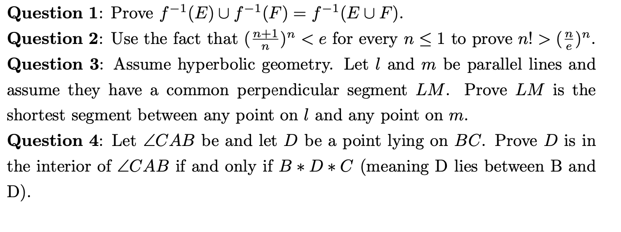
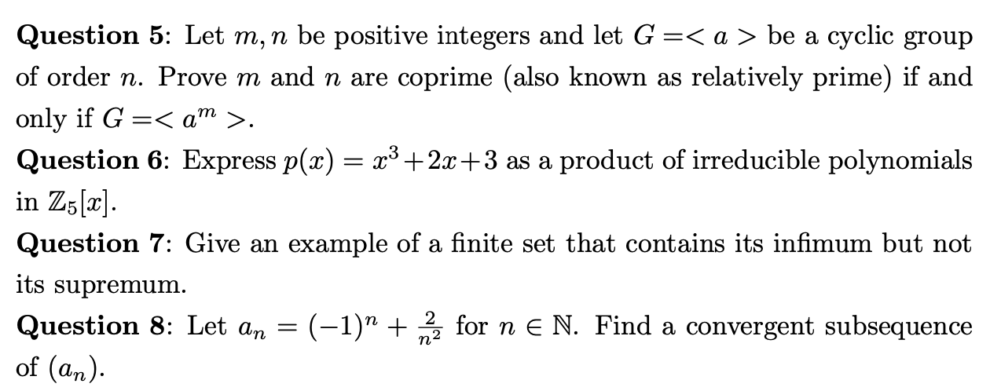
Questions

